Slide 1





Advancing Glaucoma Detection and Progression Analysis

Slide 2
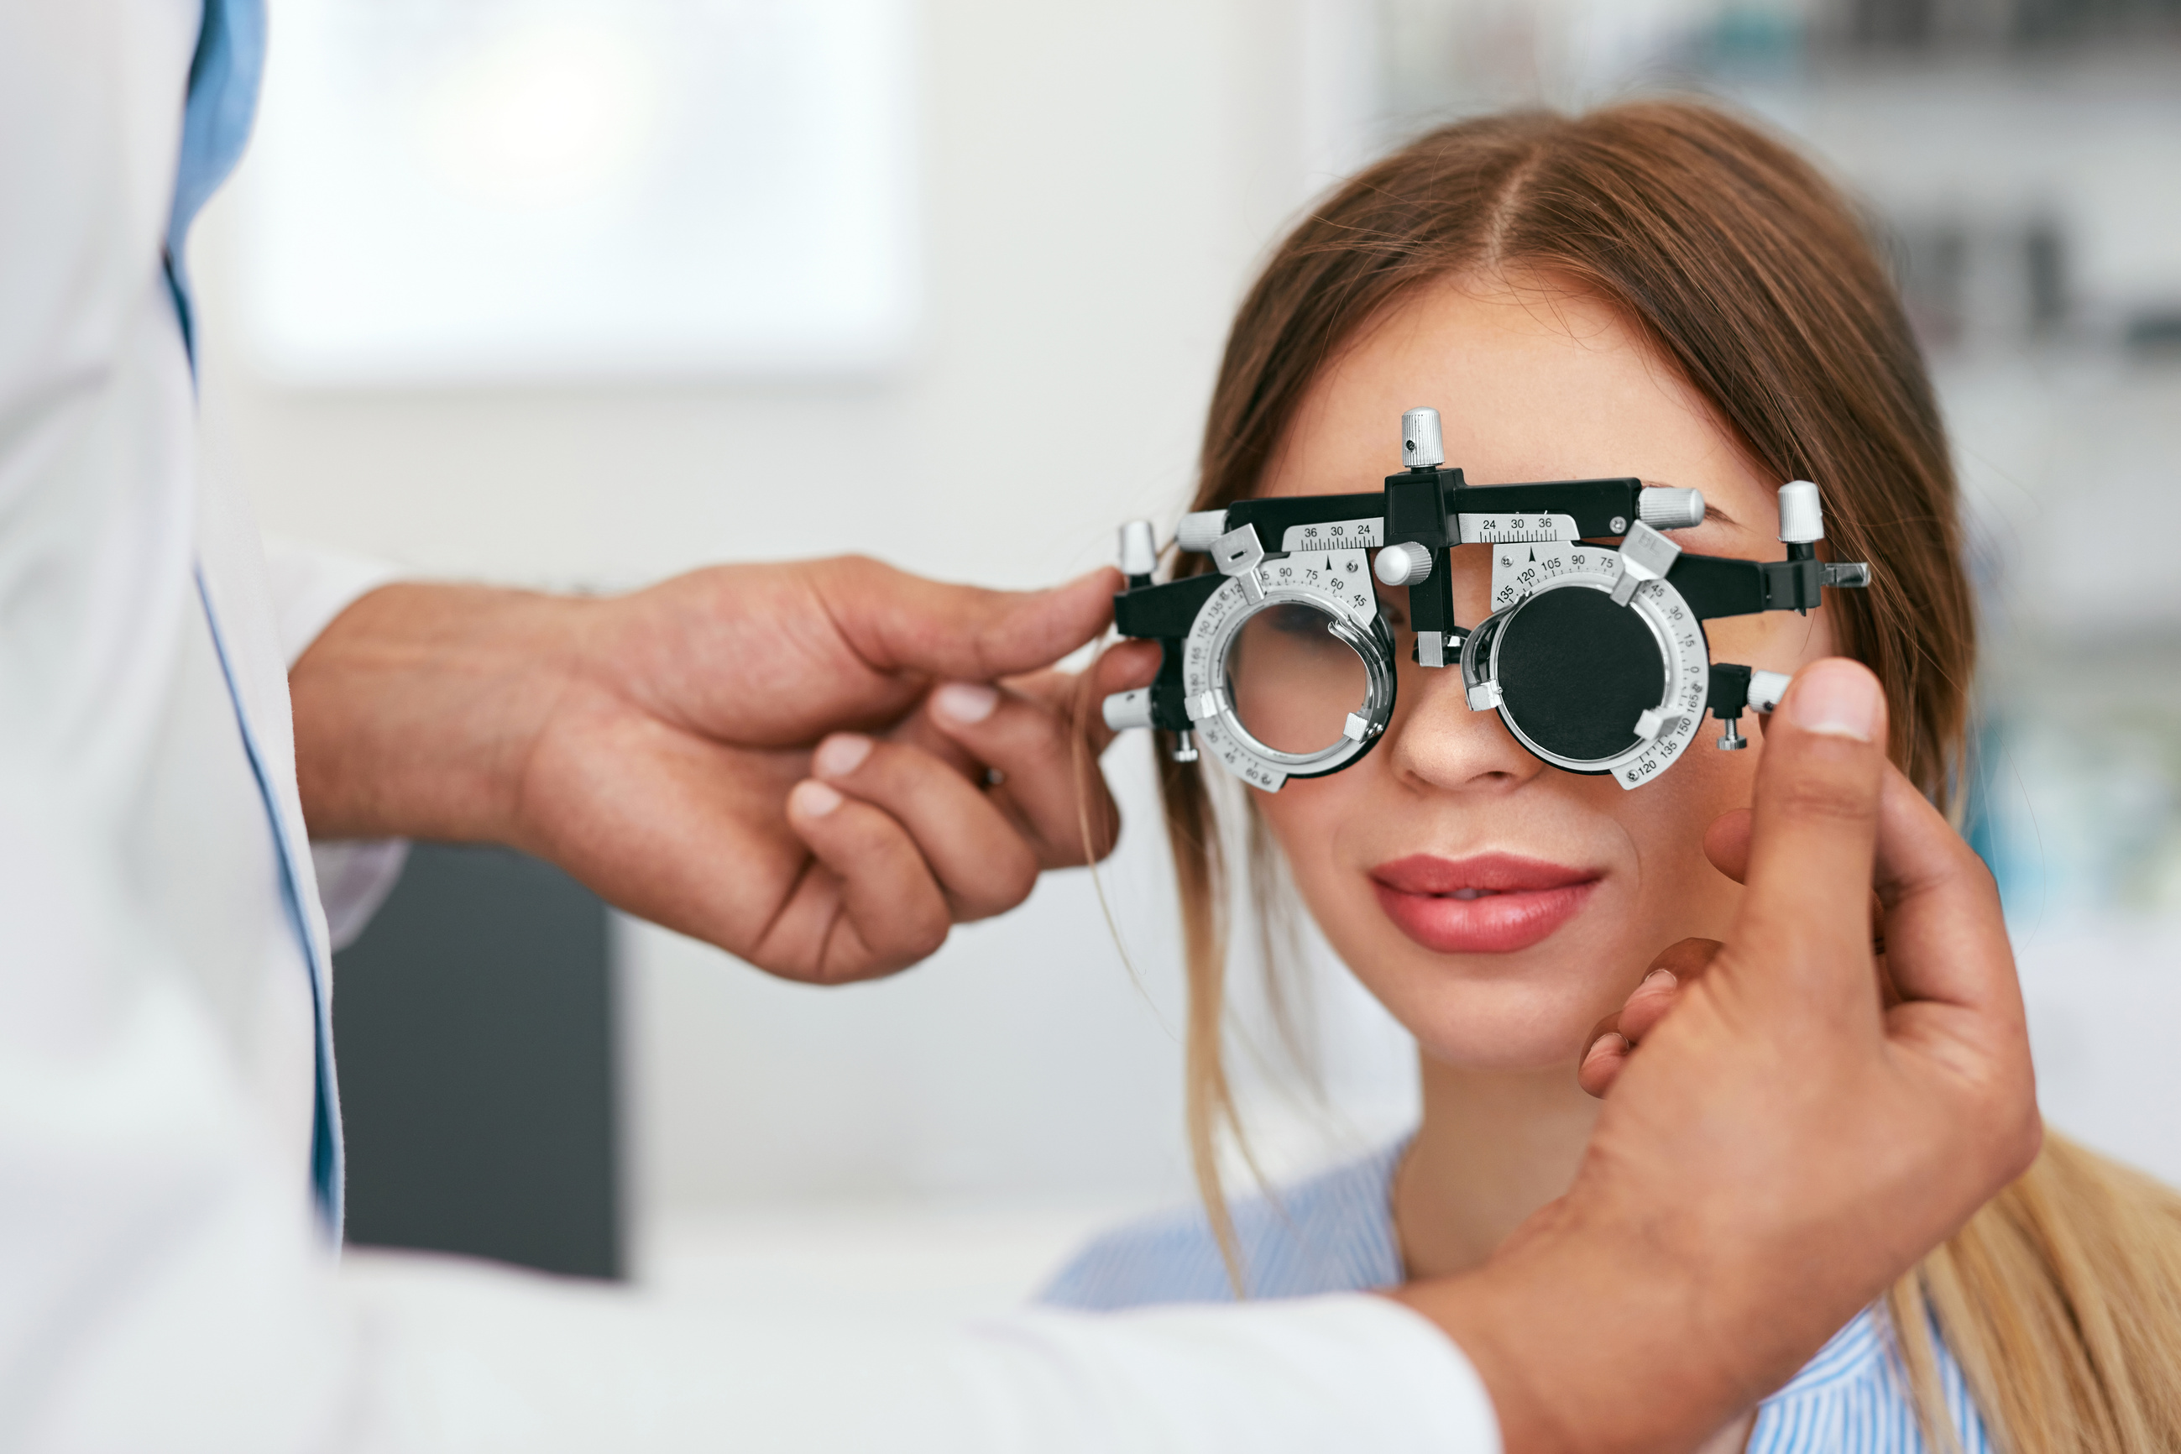
What is Glaucoma?
Glaucoma is the leading cause of blindness in the world. More than 1 in 30 adults above the age of 40 suffer from glaucoma worldwide.
Anywhere between 10% and 33% of blindness is due to glaucoma, depending on country.
Somewhere from 5-10% of glaucoma patients have rapidly progressing disease

Slide 3
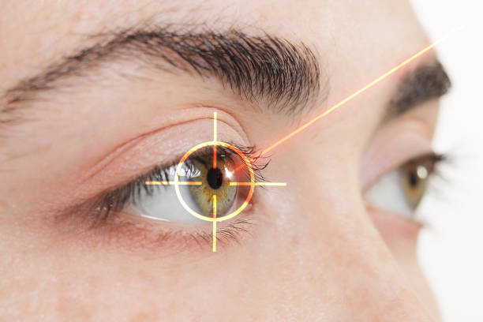
Current State of Glaucoma Detection
Treatment and Challenges
Vision loss from glaucoma can be prevented if treatment is started on time
Unfortunately, most glaucoma patients do not realize their condition until it is too late
Diagnosis
Historically patients were checked for Glaucoma using 2D scans of their eyes.
Recently, getting 3D scans using an optical coherence tomography machine has become the new standard
This provides a more detailed view of the eye in order to detect glaucoma
Tracking Progression
Progression is currently tracked linearly, simply whether or not the disease has progressed

Slide 4
Machine Learning in Glaucoma Detection
1.
Integrating AI with OCT Machines
2.
Leveraging Patient Data for Precision
To more effectively detect glaucoma, by training the model to identify the major markers
Incorporating attributes like age, race, and other health factors to broaden the scope of analysis and ensures more accurate detection and tracking.
But how?
Detection with Convolutional Neural Networks
Progression Tracking with Advanced Analytics
3.
Using CNNs to analyze OCT images, distinguishing between healthy and glaucomatous eyes. Include other patient data like age, race etc to improve diagnosis
4.
After initial detection, tracking progression through logistic regression and survival analysis, something companies today lack.

Slide 5
GLAUCOMA DETECTION AND PROGRESSION TRACKING MODEL
Phase 1: Detection
Phase 2: Progression Tracking
Model:
Initially Logistic Regression.
When the doctor has followups, move to survival analysi
Goal:
Track progression and predict deterioration
Model:
Convolutional Neural Network on 3D OCT scans and patient demographic and medical data.
Goal:
Glaucoma Identification

Slide 6
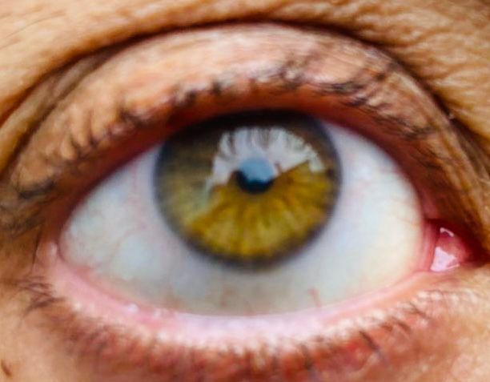
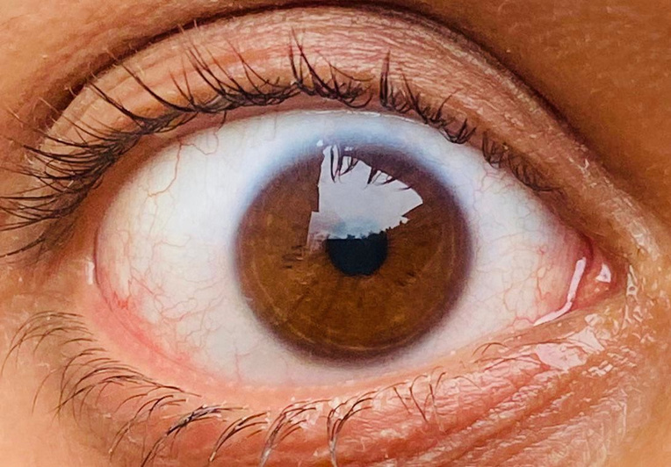
LIVE DEMO
Retinal Thickness | Mean Deviation | Age | Gender | Race
1.
2.
3.

Slide 7
LIVE DEMO
Probability | 0 - 30% | 30-50 | 50-70 | 70-100
Glaucoma Risk | Minimal chance of glaucoma | Borderline glaucoma risk | Strong chance of glaucoma | Definite glaucoma
Immediate Steps | Standard followup exams on schedule | Suggest followup tests like visual field testing and OCT analysis. Recommend patient followup in 6 months | Follow up with VF test. Patient followup in 3 months. | Follow up with VF test
Prescription | None | None necessary. Prescribe preventative eye drops if pressure borderline. | Prescribe eye drops and track progress. If condition worsens, suggest oral drops. | Consider laser therapy. Monitor progress. If condition degenerates, recommend surgery
Followup | Standard followup | Followup in 6 months | Followup in 3 months | Followup in 3 months. If condition worsens, retake

Slide 8
PROJECTED COSTS
Development
Implementation
Maintenance Costs
Write here
For model deployment
Cloud deployment: $5,000
Local deployment : $10,000
Updating Data, Storing, and Retraining the Model: $5,000
Cost Per Client:
Total: $20,000
Software Maintenance:
System servicing: $500 monthly
Bug fixes, updates
Servicing of OCT system
Monthly Cost
Total: $500
Model Training
CPU : $4000
AMD Thread ripper or Intel Xeon Gold
RAM: $2,000
ECC RAM
GPU: $20,000
Storage: $1,200
Motherboard and Power Supply: $1,000, cooling system $300
One Time Cost:
Total: $28,500
Add name here
Write here
Write here
Add name here
Write here
Write here
Add name here
Write here
Write here
Add name here
Write here
Collaborative meetings are the best! Click "Share," add your teammates, and start interacting.
$28,000+ $20,000+$500= $49,000

Slide 9
INCOME MODEL
Subscription
Licensing
Selling
Write here
Add name here
Write here
Write here
Add name here
Write here
Customers: Hospitals and clinics
Model: monthly subscription
Income: $150/clinic
$150 x 50 = $7,500
Breakeven: 7 months
Customers: OCT companies
Model: licensing
Income: $50,000/company
Breakeven: Immediate
Customers: Hospitals and clinics
Model: selling the model
Income: $40,000/hospital
Breakeven: Immediate
Write here
Add name here
Write here
Write here
Add name here
Write here
Collaborative meetings are the best! Click "Share," add your teammates, and start interacting.

Slide 10
Risks and Mitigation Strategies
Technological Risks
Data Challenges
False negatives are a significant risk as they can lead to untreated glaucoma, potentially resulting in blindness for the patient.
Mitigation:
Optimize model sensitivity to minimize false negatives, even at the cost of a few more false positives.
Model output gives different degrees instead of a binary yes or no
Lack of access to diverse and representative OCT datasets.
Mitigation:
Partner with research institutions, hospitals, and organizations for data-sharing agreements.
Ensure datasets are anonymized to address privacy concerns.
Liability Risks
Market Competition
Errors in diagnosis leading to legal challenges.
Mitigation:
Position AI as a decision-support tool with clinician oversight and final say.
Align AI solutions with healthcare regulations to reduce compliance risks
Existing software in the market may already have established trust and familiarity among doctors, making it difficult for them to switch unless the new solution is cost-effective or significantly superior.
Mitigation:
Offer competitive pricing models
Improved User Experience
.

Slide 11
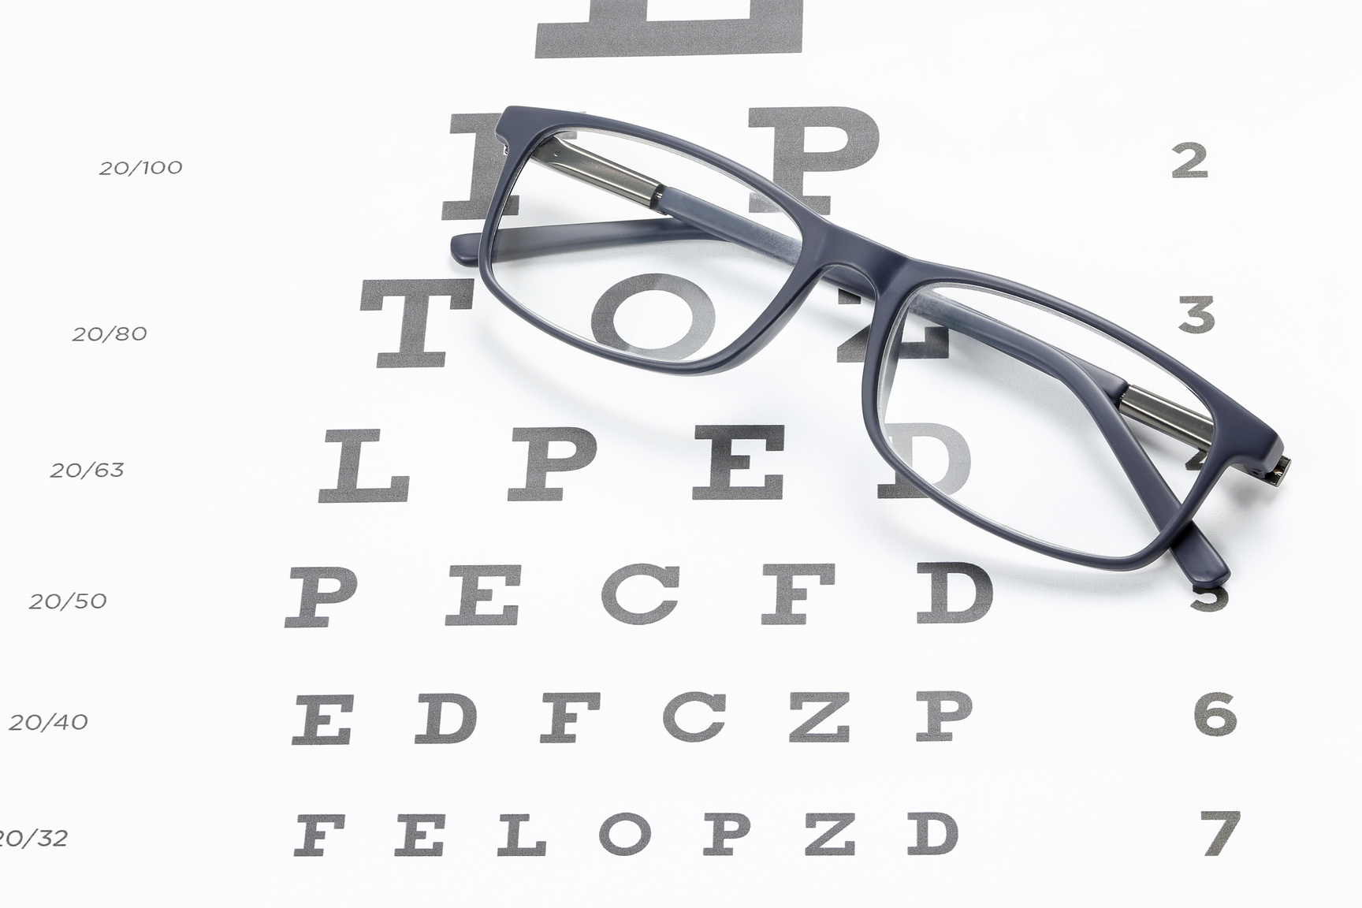
Ethical Considerations and Regulatory Frameworks
1.
Human-Centered Approach
3.
Data privacy
Replacing human clinicians entirely with AI can depersonalize care, which might be unethical or lead to poor patient outcomes. We should ensure AI is used as a support tool, and an aid, not the final judge, preserving the the human element and human understanding in disease detection
Ensure patient anonymity is protected and no identifiers are included in the model or anywhere outside the doctor’s office.
2.
Patient Autonomy
Patients may feel uncertain or mistrustful if they are unaware of AI involvement, which might violate their autonomy. For this we have to build trust through transparency.

Slide 12
This model is the only one in Canada tracking glaucoma progression, in a statistically sound manner and offers doctors greater help in effective treatment

Slide 13
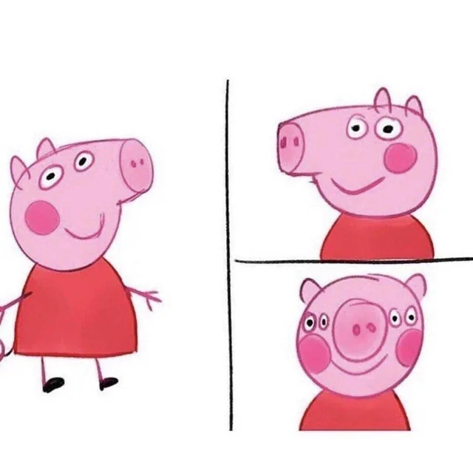
PEPPA PIG
PEPPA HAS FOUR EYES. WHAT IS HER CHANCE OF GLAUCOMA?
NONE, SHE IS A PIG

